Slide 1
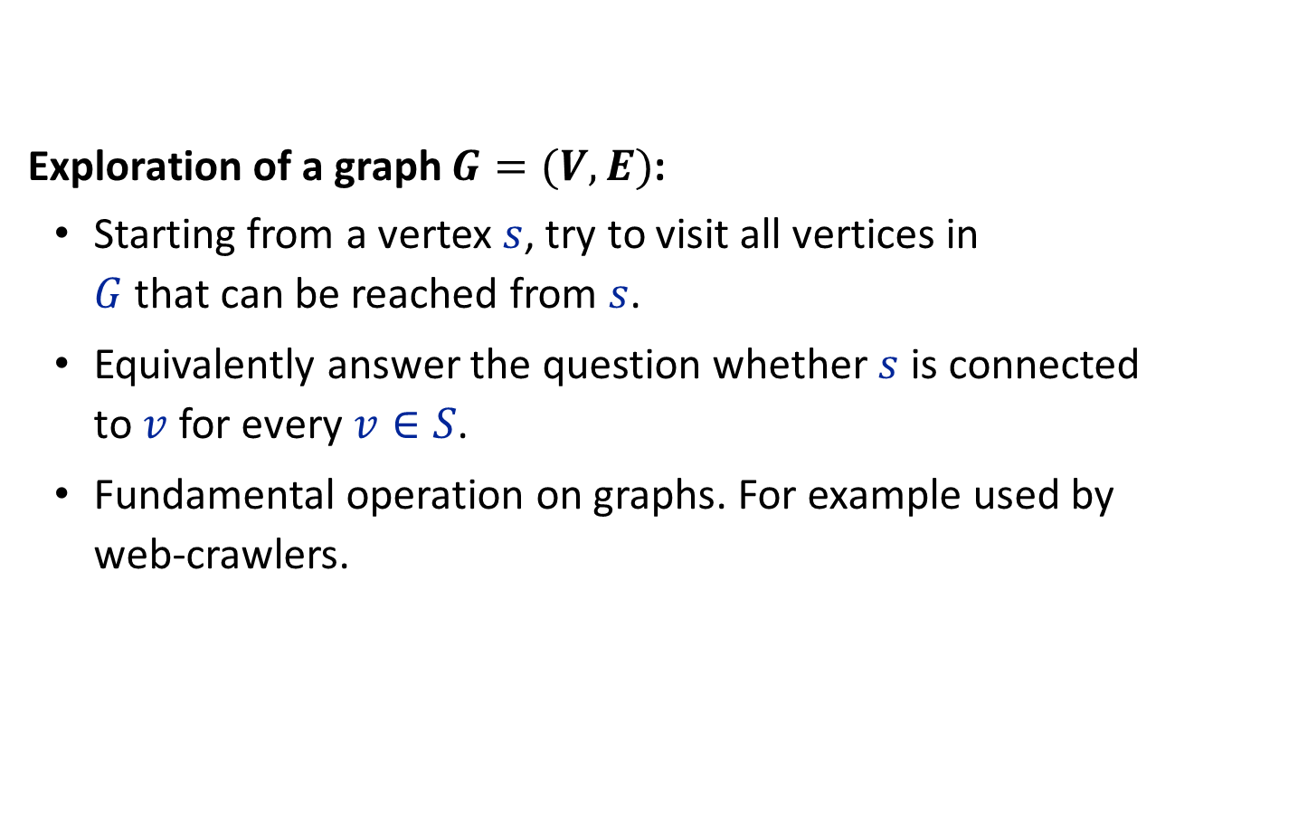
Graph Exploration
Exploration of a graph $G=(V,E)$:
Starting from a vertex $s$, try to visit all vertices in $G$ that can be reached from $s$.
Equivalently answer the question whether $s$ is connected to $v$ for every $v∈S$.
Fundamental operation on graphs. For example used by web-crawlers.

Slide 2
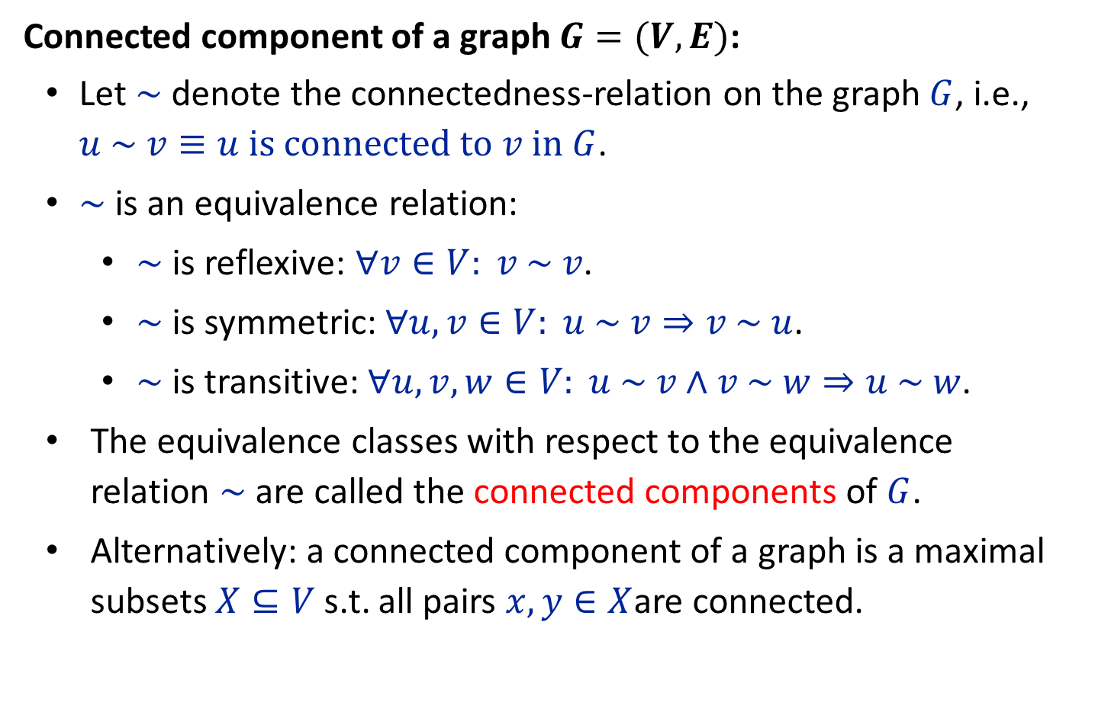
Graph Exploration
Connected component of a graph $G=(V,E)$:
Let $\sim$ denote the connectedness-relation on the graph $G$, i.e., $u \sim v≡u \text{is} \text{connected} \text{to} v \text{in} G$.
$\sim$ is an equivalence relation:
$\sim$ is reflexive: $∀v∈V: v \sim v$.
$\sim$ is symmetric: $∀u,v∈V: u \sim v⇒v \sim u$.
$\sim$ is transitive: $∀u,v,w∈V: u \sim v∧v \sim w⇒u \sim w$.
The equivalence classes with respect to the equivalence relation $\sim$ are called the connected components of $G$.
Alternatively: a connected component of a graph is a maximal subsets $X⊆V$ s.t. all pairs $x,y∈X$are connected.

Slide 3
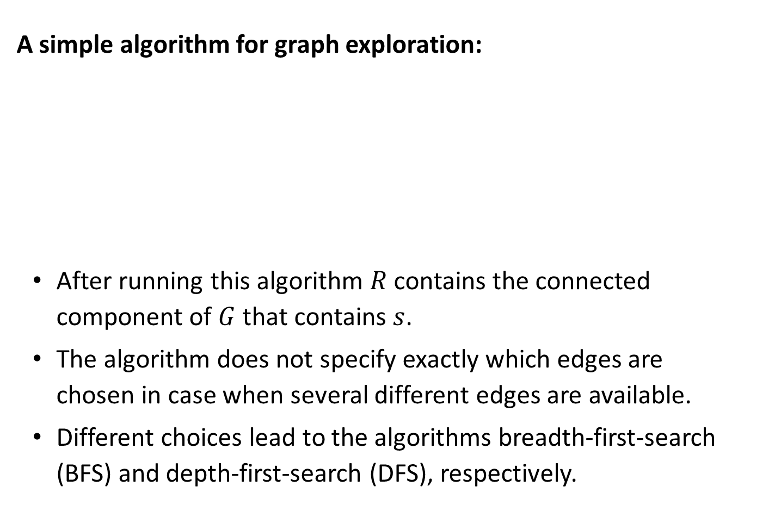
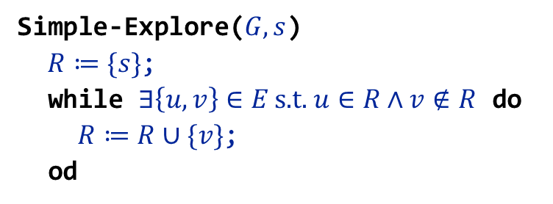
A simple algorithm for graph exploration:
After running this algorithm $R$ contains the connected component of $G$ that contains $s$.
The algorithm does not specify exactly which edges are chosen in case when several different edges are available.
Different choices lead to the algorithms breadth-first-search (BFS) and depth-first-search (DFS), respectively.
Simple-Explore($G,s$)
$R≔\{s\}$;
while $∃\left\{u,v\right\}∈E \text{s}\text{.}\text{t}\text{. }u∈R∧v∉R$ do
$R≔R∪\{v\}$;
od
Notes:
flow across cut (L ∪ s, R ∪ t) = flow entering t = k

Slide 4

BFS($G,s$)
let $R$ be a queue;
$T ≔∅$;
$R$.enqueue($(s,s)$); // add an artificial self-loop to $s$
while $R≠∅$ do
$(x,y)≔R$.dequeue();
if $y$ is unvisited then
visit $y$;
$T≔T∪\{(x,y)\}$;
forall $\left\{y,z\right\}∈E$ do if $z$ is unvisited then
$R$.enqueue($(y,z)$);
od
fi
od
remove $(s,s)$ from $T;$ // remove artificial self-loop from $T$
Notes:
flow across cut (L ∪ s, R ∪ t) = flow entering t = k

Slide 5



























Breadth First Search
$\left(17,10\right)$​
$\left(3,38\right)$​
$\left(3,27\right)$​
$\left(37,30\right)$​
0
$\left(37,24\right)$​
$\left(6,34\right)$​
$\left(6,17\right)$​
$\left(28,23\right)$​
7
18
$\left(28,11\right)$​
$\left(15,20\right)$​
22
28
$\left(15,4\right)$​
$\left(5,32\right)$​
27
30
23
11
$\left(5,25\right)$​
16
40
26
13
5
1
35
15
$\left(22,30\right)$​
3
37
32
4
$\left(22,27\right)$​
$\left(16,17\right)$​
38
12
2
24
9
36
39
29
$\left(16,3\right)$​
21
14
$\left(13,37\right)$​
$\left(13,6\right)$​
10
31
34
19
33
8
$\left(18,28\right)$​
$\left(18,15\right)$​
17
6
25
20
$\left(18,5\right)$​
$\left(7,22\right)$​
$\left(7,16\right)$​
$\left(7,13\right)$​
$\left(0,18\right)$​
$\left(0,7\right)$​

Slide 6


























Breadth First Search
$\left(23,1\right)$​
$\left(11,35\right)$​
$\left(20,8\right)$​
0
$\left(4,29\right)$​
$\left(4,11\right)$​
$\left(32,23\right)$​
$\left(32,9\right)$​
7
18
$\left(25,20\right)$​
$\left(25,19\right)$​
22
28
$\left(30,26\right)$​
$\left(27,40\right)$​
27
30
23
11
$\left(17,10\right)$​
16
13
5
15
$\left(3,38\right)$​
3
40
26
37
32
1
35
4
$\left(3,27\right)$​
$\left(37,30\right)$​
12
2
36
39
$\left(37,24\right)$​
38
24
9
29
$\left(6,34\right)$​
21
14
$\left(6,17\right)$​
31
33
$\left(28,23\right)$​
10
34
19
8
$\left(28,11\right)$​
$\left(15,20\right)$​
17
6
25
20
$\left(15,4\right)$​
$\left(5,32\right)$​
$\left(5,25\right)$​
$\left(22,30\right)$​
$\left(22,27\right)$​

Slide 7


























Breadth First Search
$\left(26,2\right)$​
$\left(40,26\right)$​
$\left(40,12\right)$​
0
$\left(10,31\right)$​
$\left(38,12\right)$​
$\left(38,10\right)$​
$\left(24,2\right)$​
7
18
$\left(34,31\right)$​
$\left(34,24\right)$​
22
28
$\left(23,1\right)$​
$\left(11,35\right)$​
27
30
23
11
$\left(20,8\right)$​
16
13
5
15
$\left(4,29\right)$​
3
40
26
37
32
1
35
4
$\left(4,11\right)$​
$\left(32,23\right)$​
12
2
36
39
$\left(32,9\right)$​
38
24
9
29
$\left(25,20\right)$​
21
14
$\left(25,19\right)$​
31
33
$\left(30,26\right)$​
10
34
19
8
$\left(27,40\right)$​
17
6
25
20
$\left(17,10\right)$​
$\left(3,38\right)$​
$\left(3,27\right)$​
$\left(37,30\right)$​
$\left(37,24\right)$​
$\left(6,34\right)$​

Slide 8



























Breadth First Search
$\left(1,36\right)$​
$\left(35,39\right)$​
$\left(35,1\right)$​
$\left(8,33\right)$​
0
$\left(29,39\right)$​
$\left(29,8\right)$​
$\left(9,36\right)$​
$\left(19,33\right)$​
7
18
$\left(19,9\right)$​
$\left(26,2\right)$​
22
28
$\left(40,26\right)$​
$\left(40,12\right)$​
27
30
23
11
$\left(10,31\right)$​
16
13
5
15
$\left(38,12\right)$​
3
40
26
37
32
1
35
4
$\left(38,10\right)$​
$\left(24,2\right)$​
12
2
36
39
$\left(34,31\right)$​
38
24
9
29
$\left(34,24\right)$​
21
14
$\left(23,1\right)$​
31
33
$\left(11,35\right)$​
10
34
19
8
$\left(20,8\right)$​
17
6
25
20
$\left(4,29\right)$​
$\left(4,11\right)$​
$\left(32,23\right)$​
$\left(32,9\right)$​
$\left(25,20\right)$​
$\left(25,19\right)$​

Slide 9
























Breadth First Search
$\left(39,14\right)$​
0
$\left(36,14\right)$​
$\left(33,14\right)$​
$\left(12,21\right)$​
$\left(2,21\right)$​
7
18
$\left(31,21\right)$​
$\left(1,36\right)$​
22
28
$\left(35,39\right)$​
$\left(35,1\right)$​
27
30
23
11
$\left(8,33\right)$​
16
13
5
15
$\left(29,39\right)$​
3
40
26
37
32
1
35
4
$\left(29,8\right)$​
$\left(9,36\right)$​
12
2
36
39
$\left(19,33\right)$​
38
24
9
29
$\left(19,9\right)$​
21
14
$\left(26,2\right)$​
31
33
$\left(40,26\right)$​
10
34
19
8
$\left(40,12\right)$​
17
6
25
20
$\left(10,31\right)$​
$\left(38,12\right)$​
$\left(38,10\right)$​
$\left(24,2\right)$​
$\left(34,31\right)$​
$\left(34,24\right)$​

Slide 10


BFS-tree:
Edges not contained in the BFS-tree can only connect successive layers, or may connect nodes on the same layer.
The BFS-tree contains a shortest $\left(s,v\right)$-path for every node $v$ reachable from $s$.
$s$​
Notes:
flow across cut (L ∪ s, R ∪ t) = flow entering t = k

Slide 11
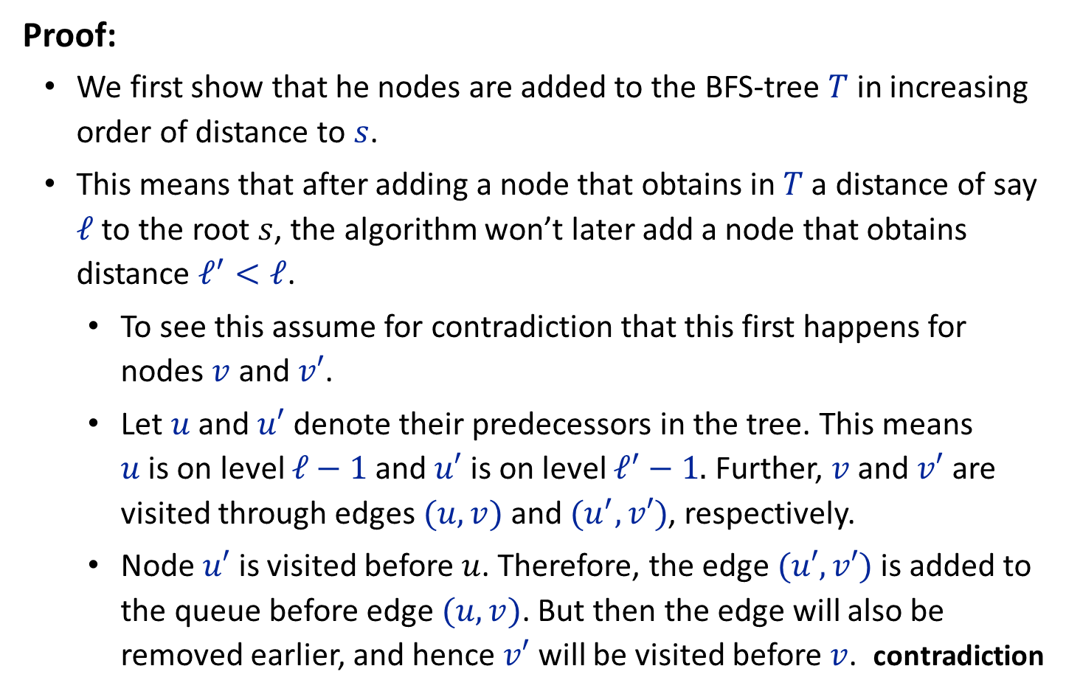
Proof:
We first show that he nodes are added to the BFS-tree $T$ in increasing order of distance to $s$.
This means that after adding a node that obtains in $T$ a distance of say $ℓ$ to the root $s$, the algorithm won’t later add a node that obtains distance $ℓ^{′}<ℓ$.
To see this assume for contradiction that this first happens for nodes $v$ and $v′$.
Let $u$ and $u′$ denote their predecessors in the tree. This means $u$ is on level $ℓ−1$ and $u′$ is on level $ℓ^{′}−1.$ Further, $v$ and $v′$ are visited through edges $(u,v)$ and $(u^{′},v′)$, respectively.
Node $u′$ is visited before $u$. Therefore, the edge $(u′,v′)$ is added to the queue before edge $(u,v)$. But then the edge will also be removed earlier, and hence $v′$ will be visited before $v$. contradiction
Notes:
flow across cut (L ∪ s, R ∪ t) = flow entering t = k

Slide 12
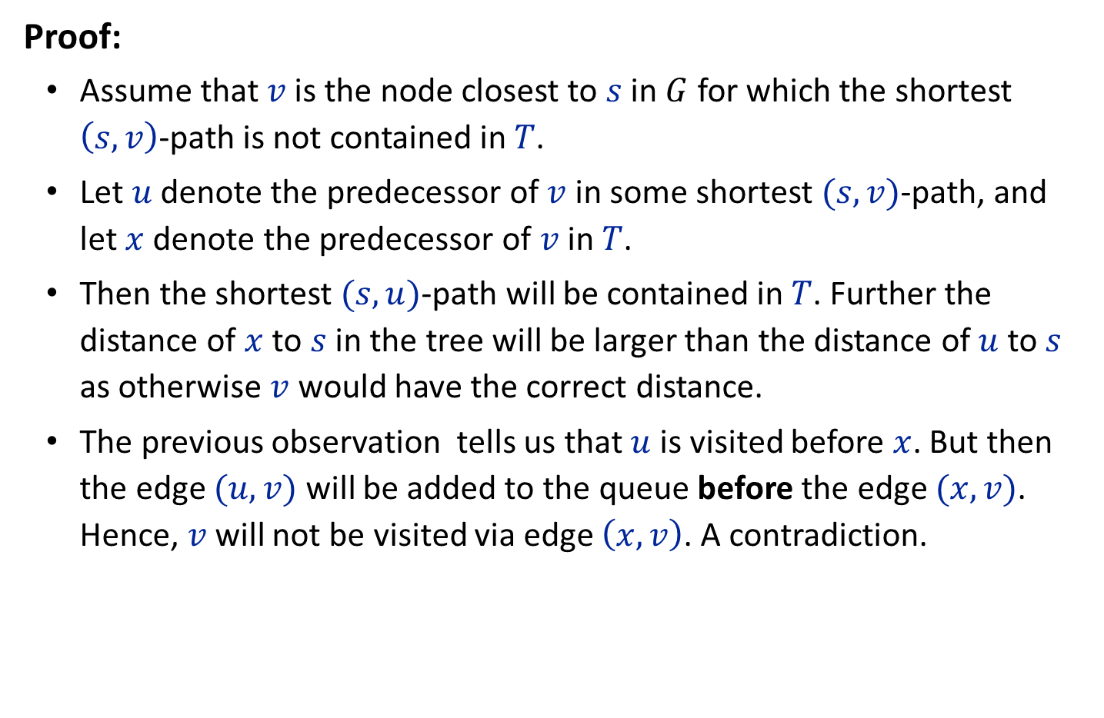
Proof:
Assume that $v$ is the node closest to $s$ in $G$ for which the shortest $\left(s,v\right)$-path is not contained in $T$.
Let $u$ denote the predecessor of $v$ in some shortest $(s,v)$-path, and let $x$ denote the predecessor of $v$ in $T$.
Then the shortest $(s,u)$-path will be contained in $T$. Further the distance of $x$ to $s$ in the tree will be larger than the distance of $u$ to $s$ as otherwise $v$ would have the correct distance.
The previous observation tells us that $u$ is visited before $x$. But then the edge $(u,v)$ will be added to the queue before the edge $(x,v)$. Hence, $v$ will not be visited via edge $\left(x,v\right)$. A contradiction.
Notes:
flow across cut (L ∪ s, R ∪ t) = flow entering t = k

Slide 13

The only difference between DFS and BFS is that DFS uses a stack instead of a queue:
DFS($G,s$)
let $R$ be a stack;
$T ≔∅$;
$R$.push($(s,s)$); // add an artificial self-loop to $s$
while $R≠∅$ do
$(x,y)≔R$.pop();
if $y$ is unvisited then
visit $y$;
$T≔T∪\{(x,y)\}$;
forall $\left\{y,z\right\}∈E$ do if $z$ is unvisited then
$R$.push($(y,z)$);
od
fi
od
remove $(s,s)$ from $T;$ // remove artificial self-loop from $T$
Notes:
flow across cut (L ∪ s, R ∪ t) = flow entering t = k

Slide 14






























































Depth First Search
$\left(25,20\right)$​
$\left(20,15\right)$​
$\left(17,16\right)​$​
0
$\left(38,10\right)$​
$\left(8,33\right)$​
$\left(33,19\right)$​
$\left(19,25\right)$​
$\left(6,13\right)$​
$\left(25,5\right)$​
$\left(10,17\right)$​
$\left(3,38\right)$​
$\left(17,6\right)$​
$\left(29,8\right)$​
$\left(4,29\right)$​
$\left(8,20\right)$​
$\left(3,16\right)$​
$\left(27,3\right)$​
$\left(40,27\right)$​
7
18
$\left(35,11\right)$​
$\left(11,4\right)$​
$\left(4,15\right)$​
$\left(12,40\right)$​
$\left(40,26\right)$​
$\left(26,2\right)$​
$\left(39,35\right)$​
22
28
$\left(35,1\right)$​
$\left(21,12\right)$​
$\left(12,38\right)$​
$\left(14,39\right)$​
$\left(39,29\right)$​
$\left(31,21\right)$​
$\left(21,2\right)$​
27
30
23
11
16
40
26
13
5
1
35
15
$\left(34,31\right)$​
$\left(36,14\right)$​
$\left(14,33\right)$​
$\left(31,10\right)$​
3
37
32
4
$\left(9,36\right)$​
$\left(36,1\right)$​
$\left(24,34\right)$​
$\left(34,6\right)$​
38
12
2
24
9
36
39
29
$\left(9,19\right)$​
$\left(32,9\right)$​
$\left(37,24\right)$​
$\left(24,2\right)$​
21
14
$\left(30,37\right)$​
$\left(32,5\right)$​
$\left(23,32\right)$​
$\left(37,13\right)$​
10
31
34
19
33
8
$\left(28,23\right)$​
$\left(23,1\right)$​
$\left(22,30\right)$​
$\left(30,26\right)$​
$\left(18,28\right)$​
17
6
25
20
$\left(28,11\right)$​
$\left(7,22\right)$​
$\left(22,27\right)$​
$\left(18,15\right)$​
$\left(7,16\right)$​
$\left(0,18\right)$​
$\left(18,5\right)$​
$\left(7,13\right)$​
$\left(0,7\right)$​

Slide 15
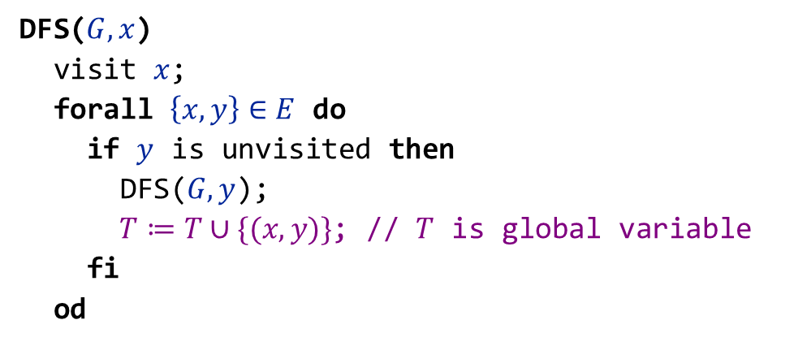
A recursive formulation of DFS:
For the two versions to be equivalent the forall-construct needs to consider edges in the opposite order. (First choose the edge with highest opposite end-point).
DFS($G,x$)
visit $x$;
forall $\left\{x,y\right\}∈E$ do
if $y$ is unvisited then
DFS($G,y$);
$T≔T∪\{(x,y)\}$; // $T$ is global variable
fi
od
Notes:
flow across cut (L ∪ s, R ∪ t) = flow entering t = k

Slide 16
DFS-tree:
Edges not contained in the DFS-tree can only connect ancestors and descendants.
$s$​
Notes:
flow across cut (L ∪ s, R ∪ t) = flow entering t = k

Slide 17
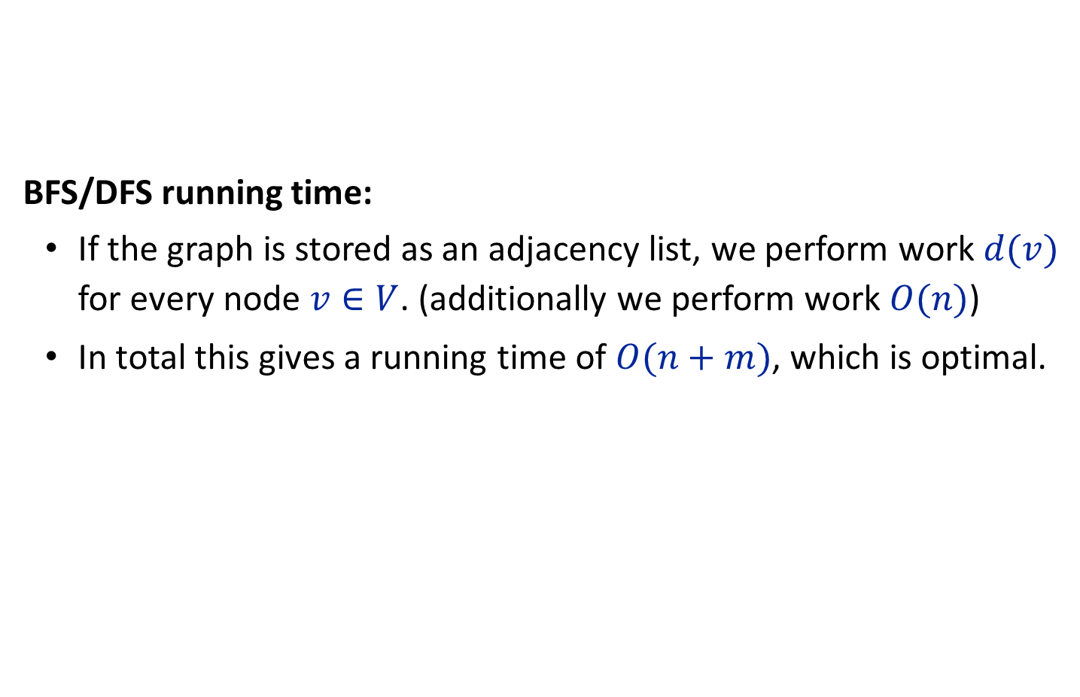
BFS/DFS running time:
If the graph is stored as an adjacency list, we perform work $d(v)$ for every node $v∈V$. (additionally we perform work $O(n)$)
In total this gives a running time of $O(n+m)$, which is optimal.
Notes:
flow across cut (L ∪ s, R ∪ t) = flow entering t = k

Slide 18
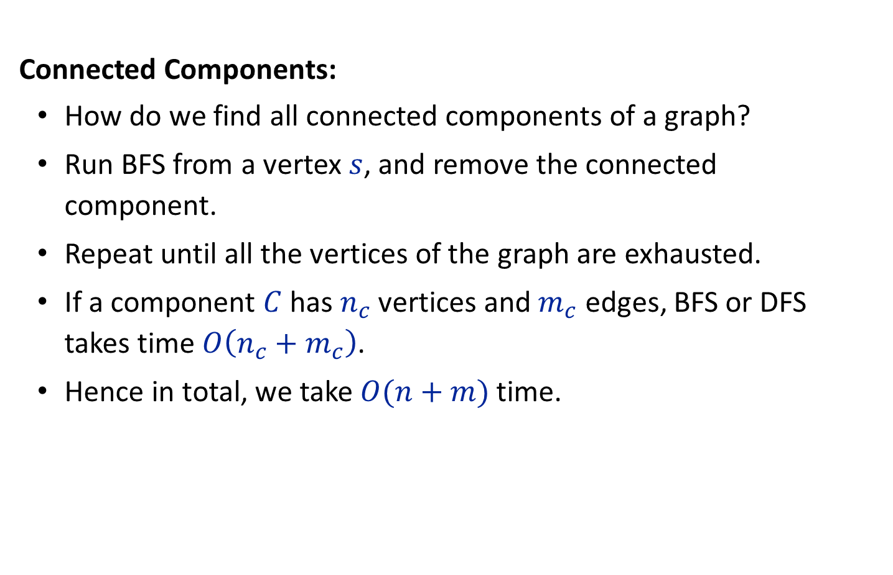
Connected Components:
How do we find all connected components of a graph?
Run BFS from a vertex $s$, and remove the connected component.
Repeat until all the vertices of the graph are exhausted.
If a component $C$ has $n_{c}$ vertices and $m_{c}$ edges, BFS or DFS takes time $O\left(n_{c}+m_{c}\right)$.
Hence in total, we take $O(n+m)$ time.
Notes:
flow across cut (L ∪ s, R ∪ t) = flow entering t = k

Slide 19
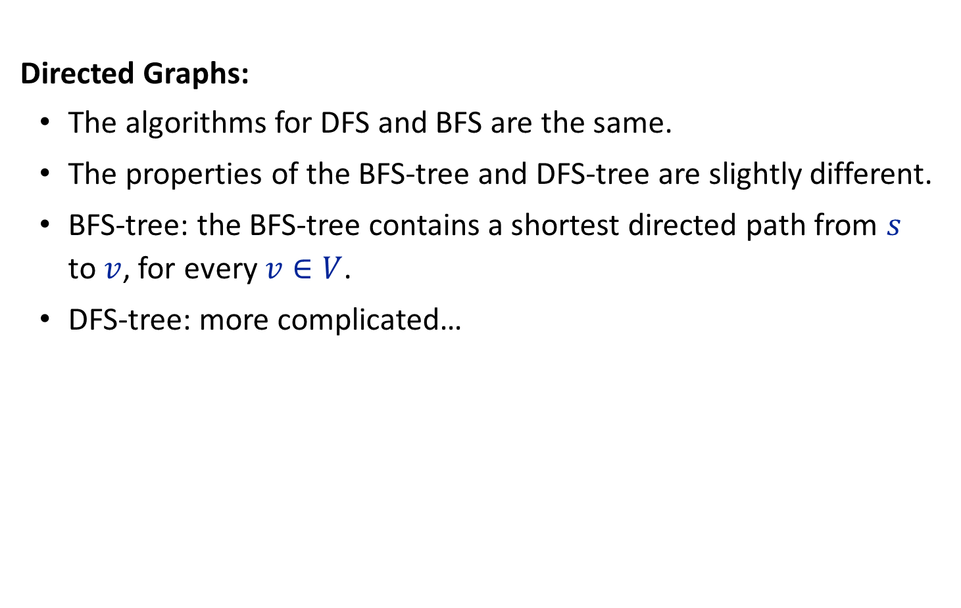
Directed Graphs:
The algorithms for DFS and BFS are the same.
The properties of the BFS-tree and DFS-tree are slightly different.
BFS-tree: the BFS-tree contains a shortest directed path from $s$ to $v$, for every $v∈V$.
DFS-tree: more complicated…
Notes:
flow across cut (L ∪ s, R ∪ t) = flow entering t = k

Slide 20

DFS numbering:
Compute in which order the recursive calls initiated by the nodes in the network finish.
$z≔0$; // global variable
$∀v∈V: N\left[v\right]≔0$; // initialize array
while $∃v∈V: N\left[v\right]=0$ do DFS($G,v$);
DFS($G,x$)
visit $x$;
forall $\left\{x,y\right\}∈E$ do
if $y$ is unvisited then
DFS($G,y$);
$T≔T∪\{(x,y)\}$; // $T$ is global variable
fi
od
$N\left[x\right]≔\text{++}z$;
Notes:
flow across cut (L ∪ s, R ∪ t) = flow entering t = k

Slide 21
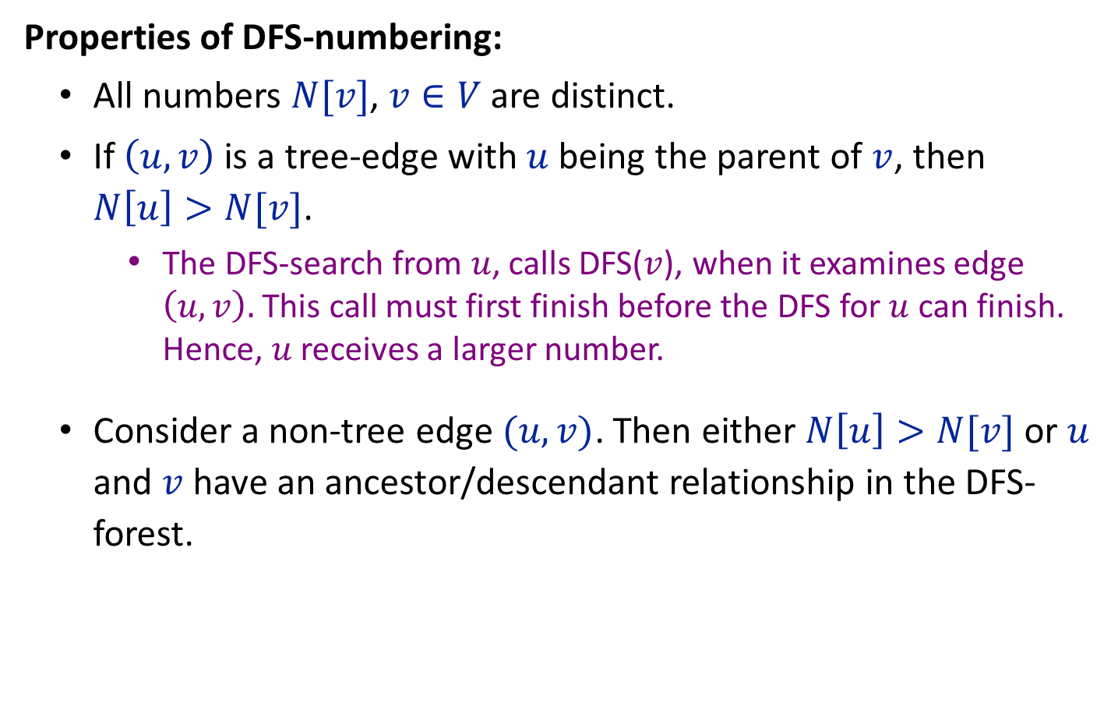
Properties of DFS-numbering:
All numbers $N[v]$, $v∈V$ are distinct.
If $\left(u,v\right)$ is a tree-edge with $u$ being the parent of $v$, then $N\left[u\right]>N[v]$.
The DFS-search from $u$, calls DFS($v$), when it examines edge $\left(u,v\right).$ This call must first finish before the DFS for $u$ can finish. Hence, $u$ receives a larger number.
Consider a non-tree edge $(u,v)$. Then either $N\left[u\right]>N[v]$ or $u$ and $v$ have an ancestor/descendant relationship in the DFS-forest.
Notes:
flow across cut (L ∪ s, R ∪ t) = flow entering t = k

Slide 22
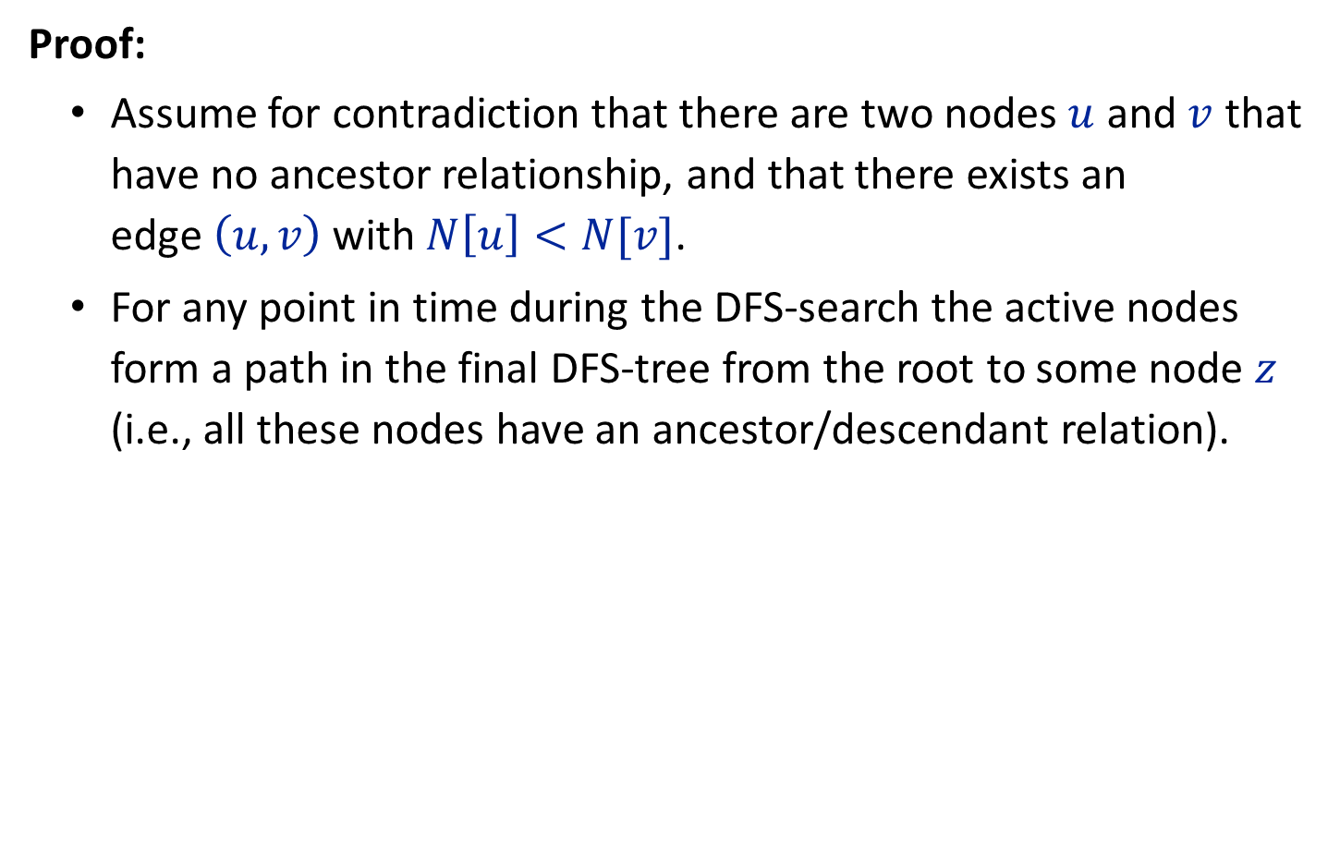
Proof:
Assume for contradiction that there are two nodes $u$ and $v$ that have no ancestor relationship, and that there exists an edge$\left(u,v\right)$ with $N\left[u\right]<N[v]$.
For any point in time during the DFS-search the active nodes form a path in the final DFS-tree from the root to some node $z$ (i.e., all these nodes have an ancestor/descendant relation).
Notes:
flow across cut (L ∪ s, R ∪ t) = flow entering t = k

Slide 23
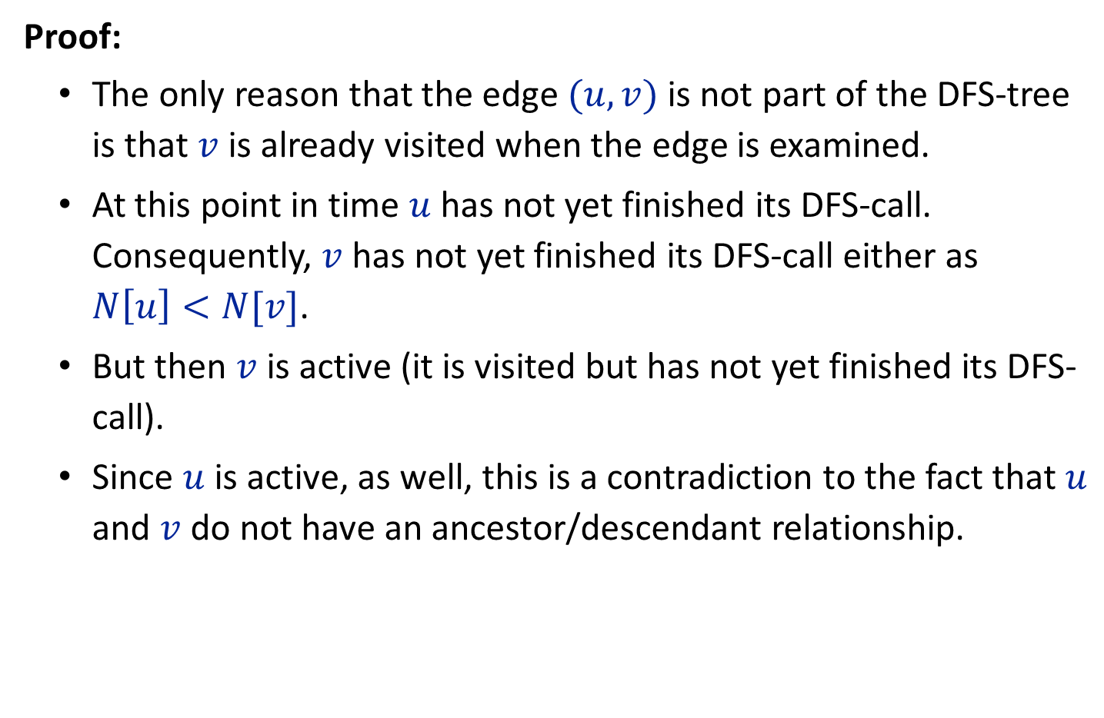
Proof:
The only reason that the edge $(u,v)$ is not part of the DFS-tree is that $v$ is already visited when the edge is examined.
At this point in time $u$ has not yet finished its DFS-call. Consequently, $v$ has not yet finished its DFS-call either as $N\left[u\right]<N[v]$.
But then $v$ is active (it is visited but has not yet finished its DFS-call).
Since $u$ is active, as well, this is a contradiction to the fact that $u$ and $v$ do not have an ancestor/descendant relationship.
Notes:
flow across cut (L ∪ s, R ∪ t) = flow entering t = k

Slide 24
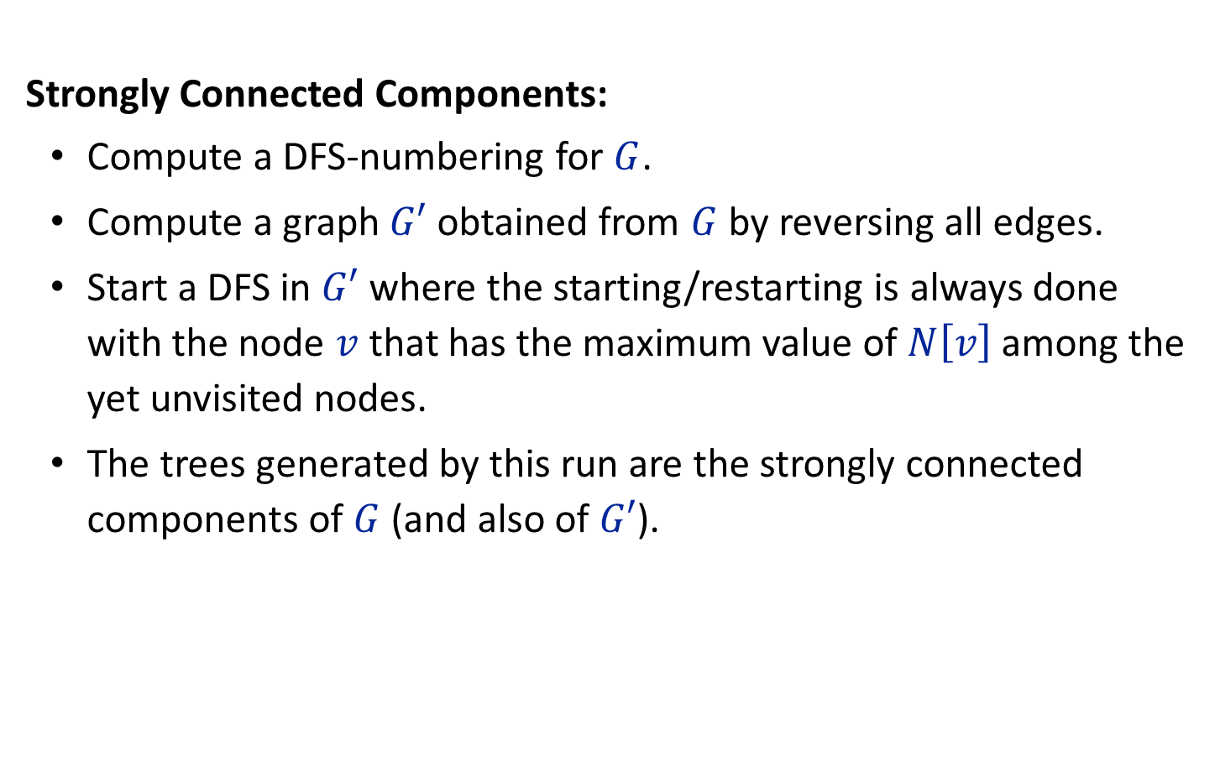
Strongly Connected Components:
Compute a DFS-numbering for $G$.
Compute a graph $G′$ obtained from $G$ by reversing all edges.
Start a DFS in $G′$ where the starting/restarting is always done with the node $v$ that has the maximum value of $N\left[v\right]$ among the yet unvisited nodes.
The trees generated by this run are the strongly connected components of $G$ (and also of $G′$).
Notes:
flow across cut (L ∪ s, R ∪ t) = flow entering t = k

Slide 25


5
4
8
Graph $G′$
3
7
6
2
1
5
4
8
Graph $G$
3
7
6
2
1
Notes:
flow across cut (L ∪ s, R ∪ t) = flow entering t = k

Slide 26
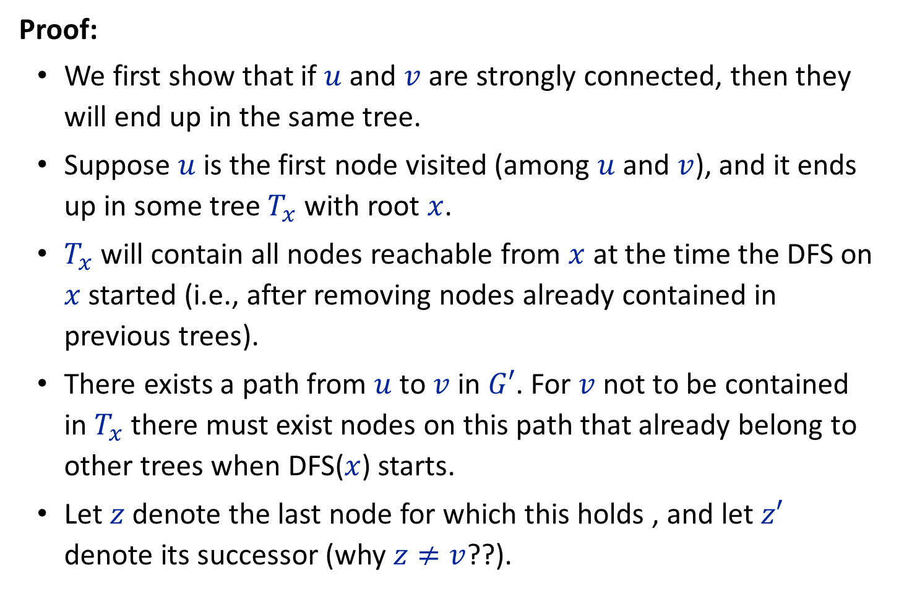
Proof:
We first show that if $u$ and $v$ are strongly connected, then they will end up in the same tree.
Suppose $u$ is the first node visited (among $u$ and $v$), and it ends up in some tree $T_{x}$ with root $x$.
$T_{x}$ will contain all nodes reachable from $x$ at the time the DFS on $x$ started (i.e., after removing nodes already contained in previous trees).
There exists a path from $u$ to $v$ in $G′$. For $v$ not to be contained in $T_{x}$ there must exist nodes on this path that already belong to other trees when DFS($x$) starts.
Let $z$ denote the last node for which this holds , and let $z′$ denote its successor (why $z≠v$??).
Notes:
flow across cut (L ∪ s, R ∪ t) = flow entering t = k

Slide 27
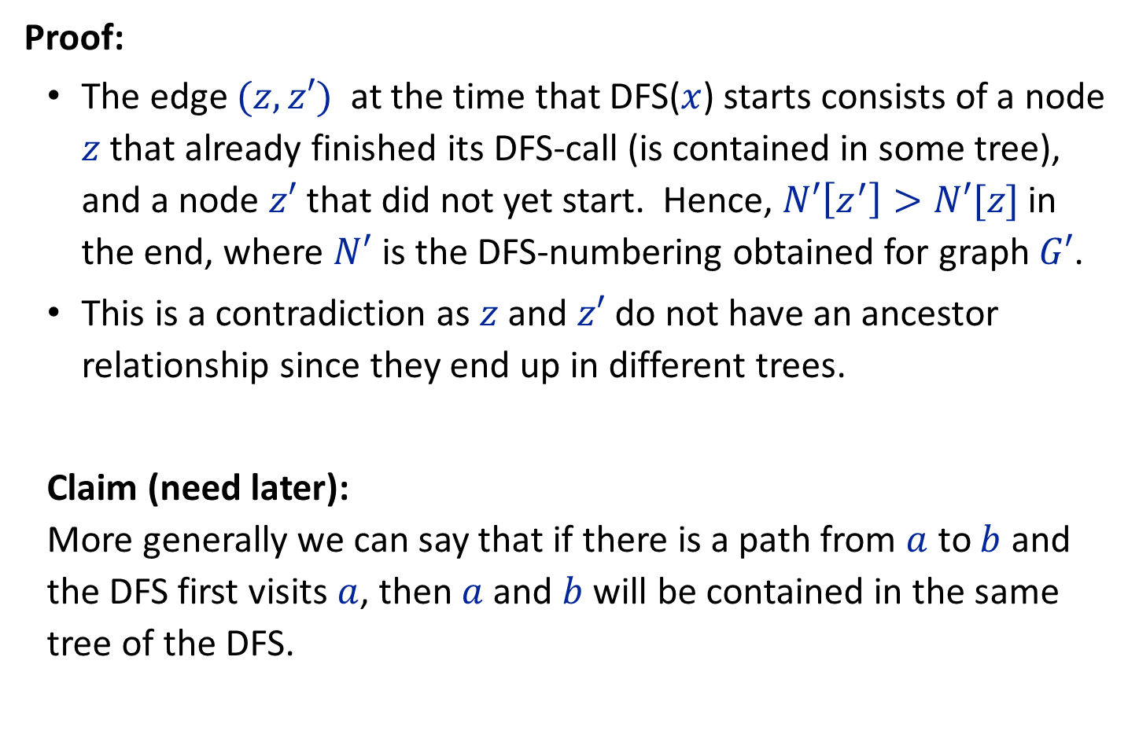
Proof:
The edge $(z,z′)$ at the time that DFS($x$) starts consists of a node $z$ that already finished its DFS-call (is contained in some tree), and a node $z′$ that did not yet start. Hence, $N′\left[z^{′}\right]>N′[z]$ in the end, where $N′$ is the DFS-numbering obtained for graph $G′$.
This is a contradiction as $z$ and $z′$ do not have an ancestor relationship since they end up in different trees.
Claim (need later): More generally we can say that if there is a path from $a$ to $b$ and the DFS first visits $a$, then $a$ and $b$ will be contained in the same tree of the DFS.
Notes:
flow across cut (L ∪ s, R ∪ t) = flow entering t = k

Slide 28
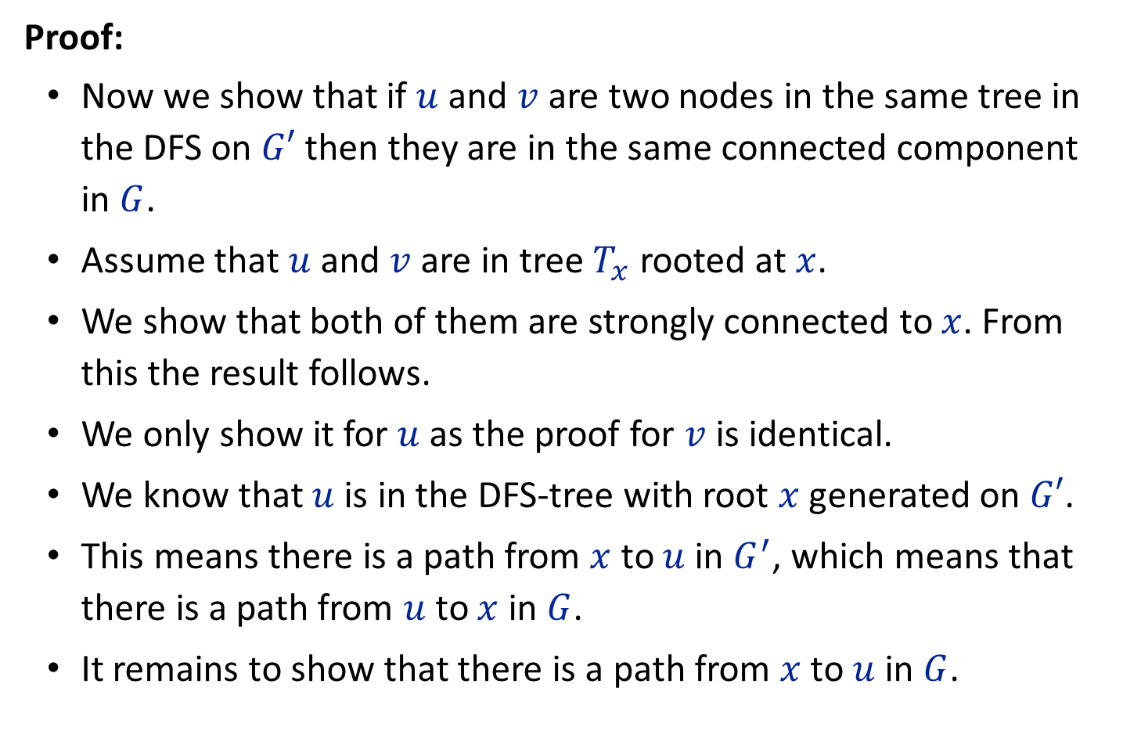
Proof:
Now we show that if $u$ and $v$ are two nodes in the same tree in the DFS on $G′$ then they are in the same connected component in $G$.
Assume that $u$ and $v$ are in tree $T_{x}$ rooted at $x$.
We show that both of them are strongly connected to $x$. From this the result follows.
We only show it for $u$ as the proof for $v$ is identical.
We know that $u$ is in the DFS-tree with root $x$ generated on $G′$.
This means there is a path from $x$ to $u$ in $G^{′}$, which means that there is a path from $u$ to $x$ in $G$.
It remains to show that there is a path from $x$ to $u$ in $G$.
Notes:
flow across cut (L ∪ s, R ∪ t) = flow entering t = k

Slide 29
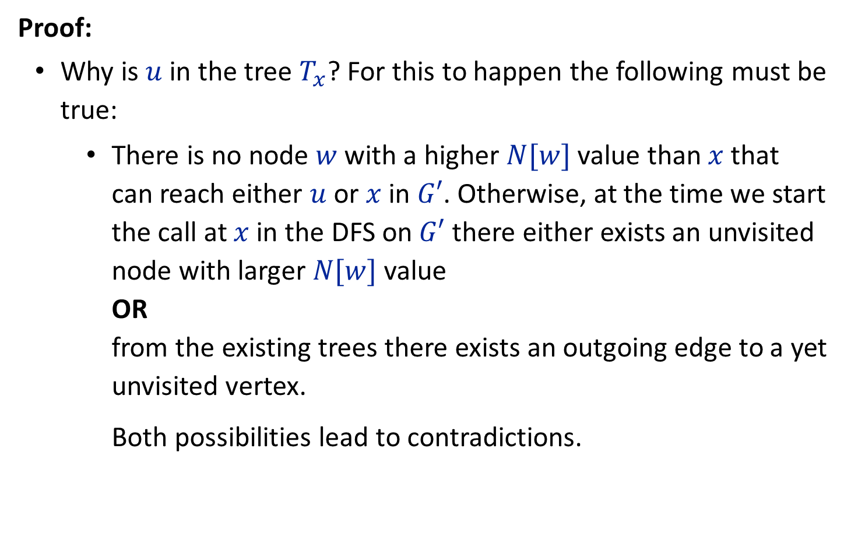
Proof:
Why is $u$ in the tree $T_{x}$? For this to happen the following must be true:
There is no node $w$ with a higher $N[w]$ value than $x$ that can reach either $u$ or $x$ in $G′$. Otherwise, at the time we start the call at $x$ in the DFS on $G′$ there either exists an unvisited node with larger $N[w]$ value OR from the existing trees there exists an outgoing edge to a yet unvisited vertex. Both possibilities lead to contradictions.
Notes:
flow across cut (L ∪ s, R ∪ t) = flow entering t = k

Slide 30
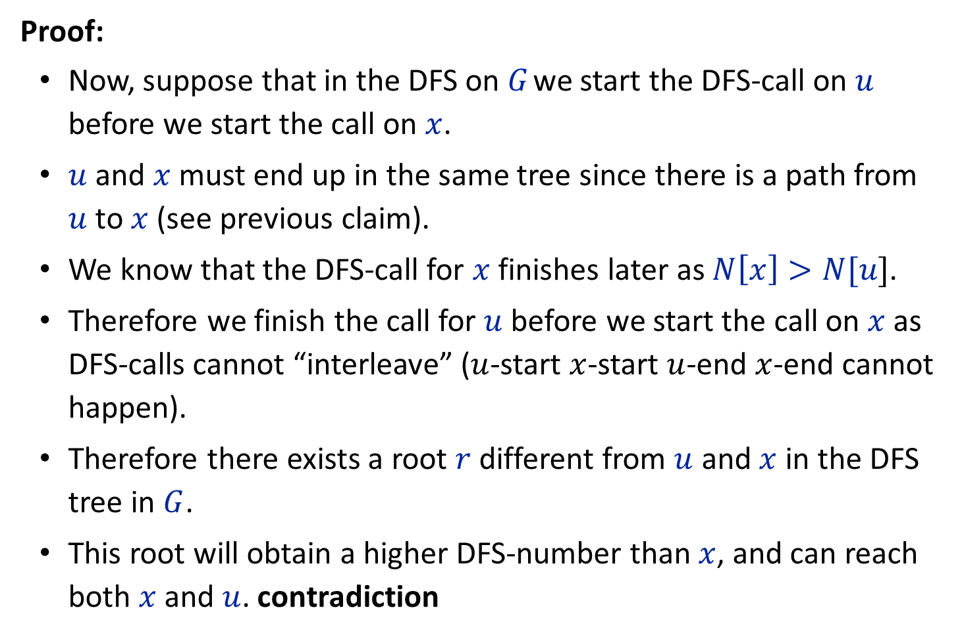
Proof:
Now, suppose that in the DFS on $G$ we start the DFS-call on $u$ before we start the call on $x$.
$u$ and $x$ must end up in the same tree since there is a path from $u$ to $x$ (see previous claim).
We know that the DFS-call for $x$ finishes later as $N\left[x\right]>N[u]$.
Therefore we finish the call for $u$ before we start the call on $x$ as DFS-calls cannot “interleave” ($u$-start $x$-start $u$-end $x$-end cannot happen).
Therefore there exists a root $r$ different from $u$ and $x$ in the DFS tree in $G$.
This root will obtain a higher DFS-number than $x$, and can reach both $x$ and $u$. contradiction
Notes:
flow across cut (L ∪ s, R ∪ t) = flow entering t = k

Slide 31

Proof:
This means in the DFS on $G$ we start the DFS-call on $x$ before we start the call on $u$.
However, in this case the search from $x$ must visit $u$ as otherwise $u$ could not obtain a lower DFS-number.
Therefore, there must exist a path from $x$ to $u$.
Notes:
flow across cut (L ∪ s, R ∪ t) = flow entering t = k

